Slide 1
ZJU-CHINA IGEM Project Introduction
Gao Jiahao

Slide 2
ZJU-CHINA-2015

Slide 3
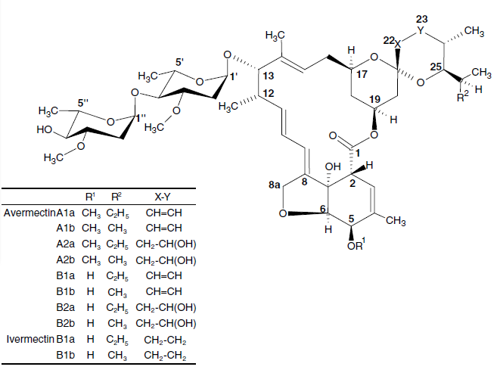
Avermectin
Expression of three key protein in the synthetic pathway
E.Coli transfer the shuttle plasmid to Streptomyces

Slide 4
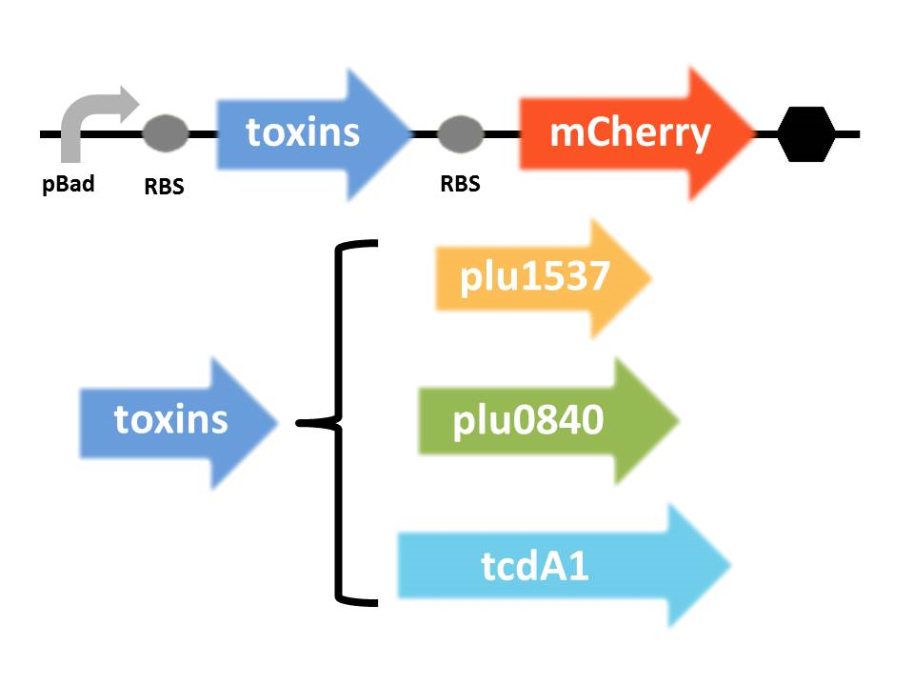
Toxic Protein
Predicted toxic protein from Photorhabdus luminescens TT01

Slide 5
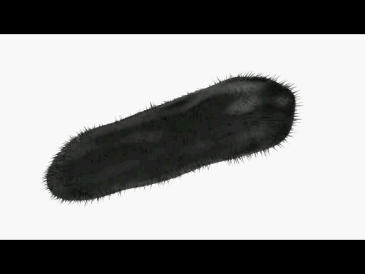
Cellulose Nano Crystal Coating

Slide 6
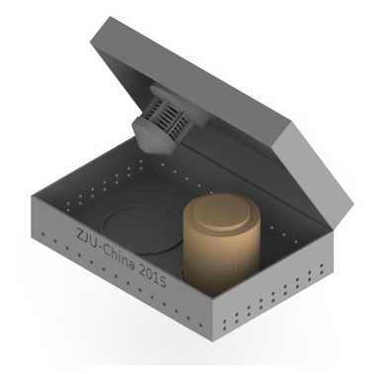
Device
Attract
Protect the environment
Effectiveness
···

Slide 7
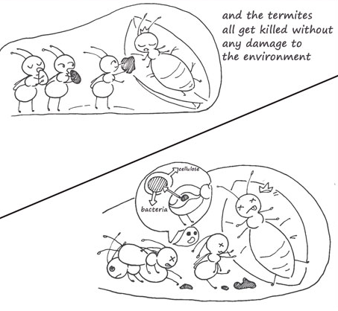
ZJU-CHINA-2015

Slide 8
ZJU-CHINA-2014

Slide 9
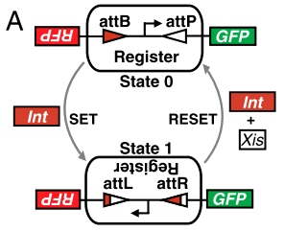
Bistable Switch
Effect:

Slide 10
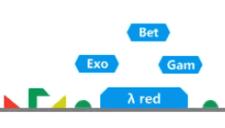
λ Red
Effect:

Slide 11
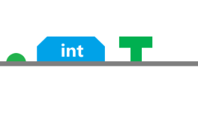
Full system

Slide 12
ZJU-CHINA-2014

Slide 13
ZJU-CHINA-2014

Slide 14
ZJU-CHINA-2013

Slide 15
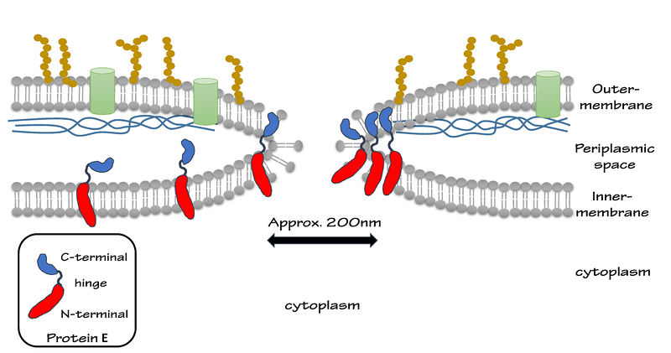
Bacterial ghost
Form holes for protein entrance
Keep periplasmic unchanged

Slide 16
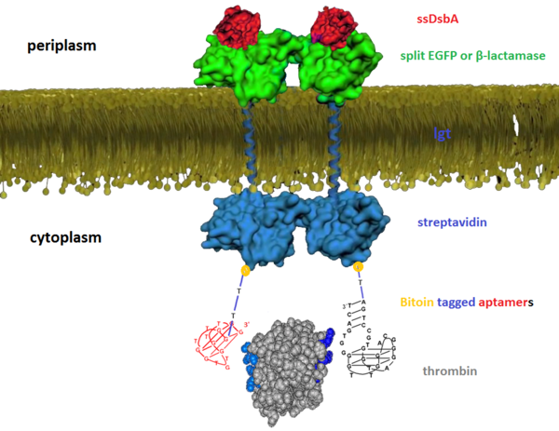
Aptamer
ssDsbA is periplasm signal
Fusing protein
Protein carrier

Slide 17
ZJU-CHINA-2012

Slide 18
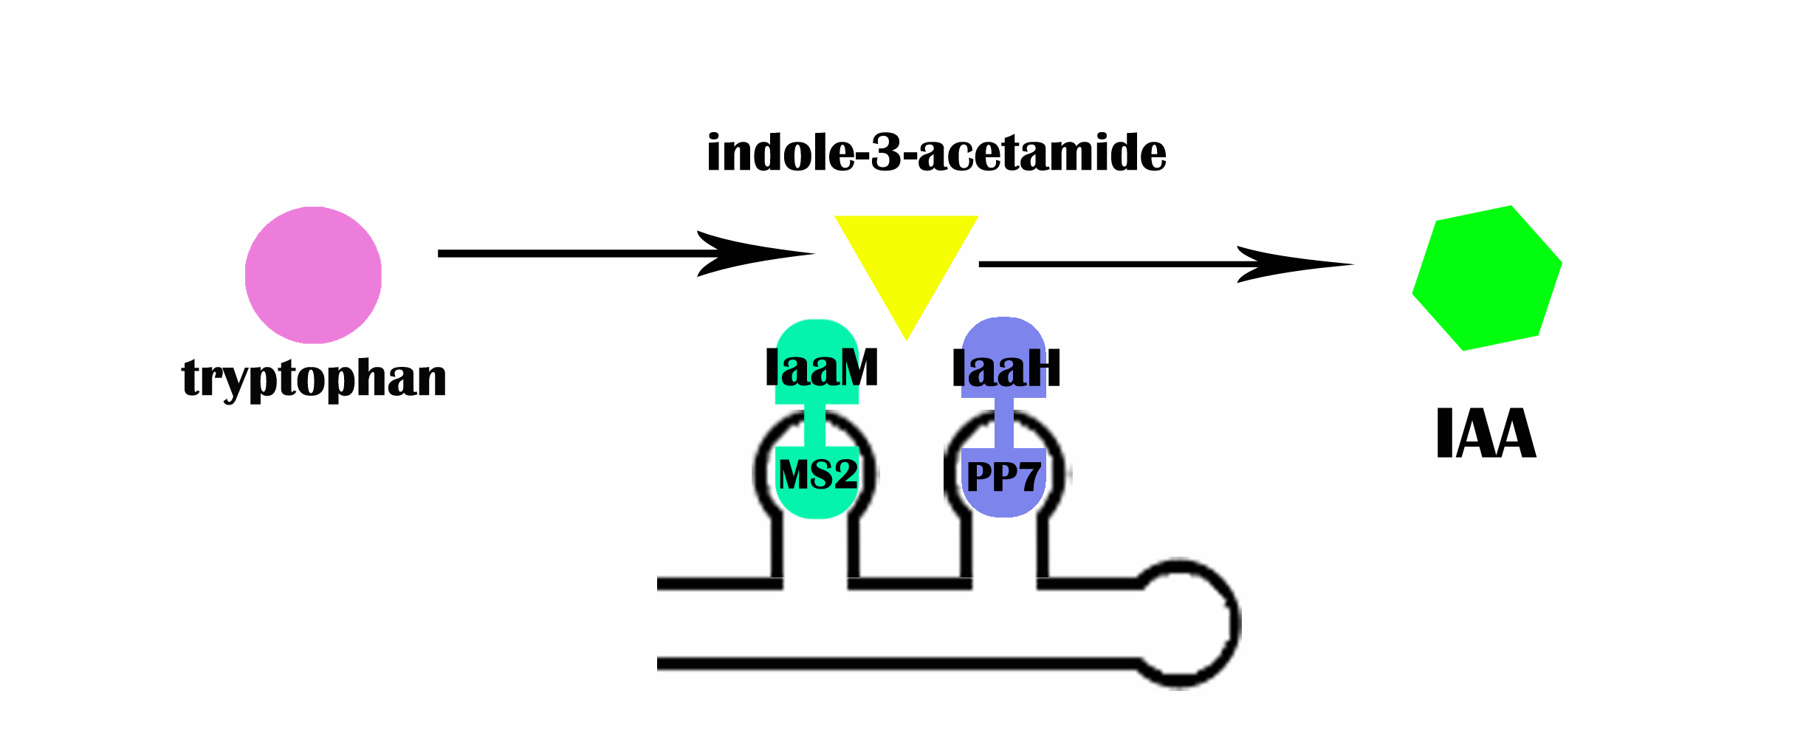
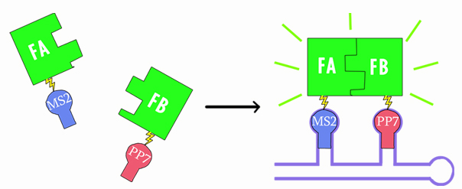
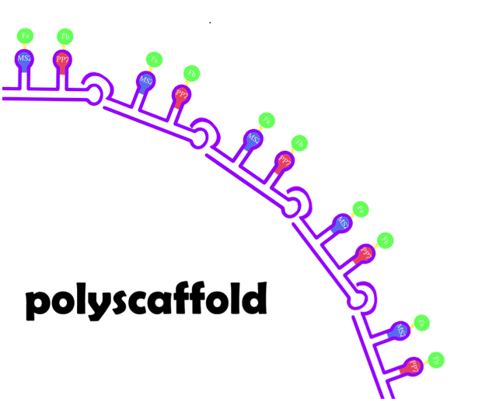
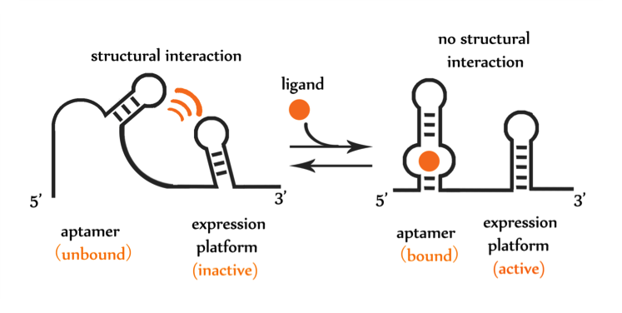
RNA Scaffold

Slide 19
ZJU-CHINA-2011

Slide 20
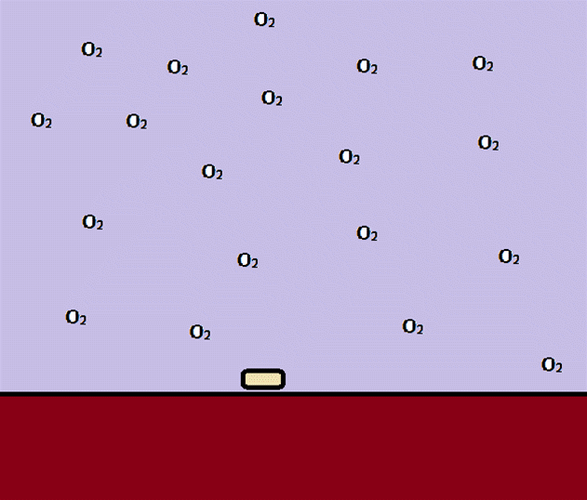
Rainbofilm

Slide 21
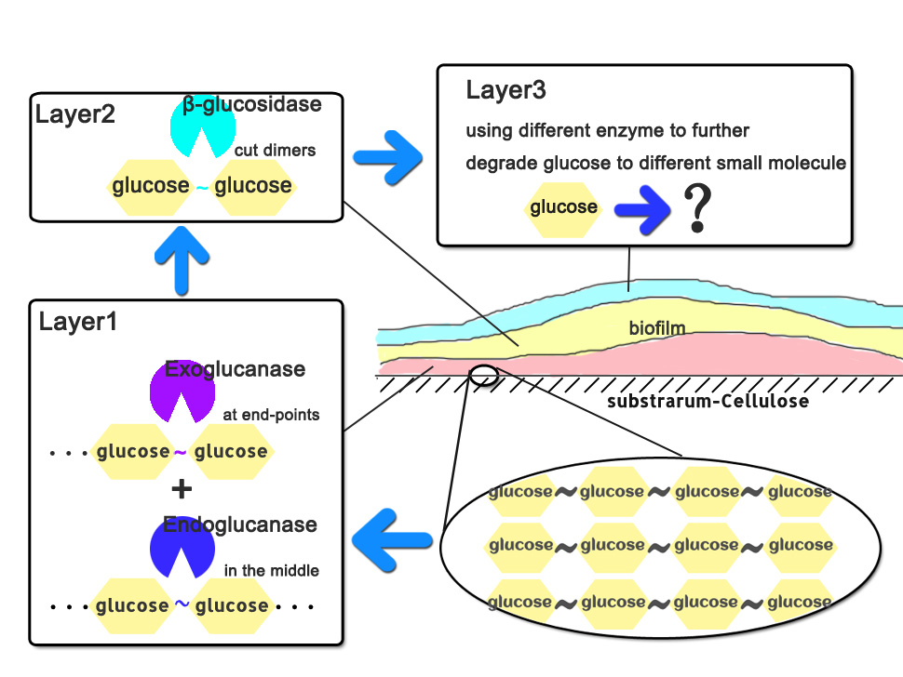
Xfilm——Sugerfilm

Slide 22
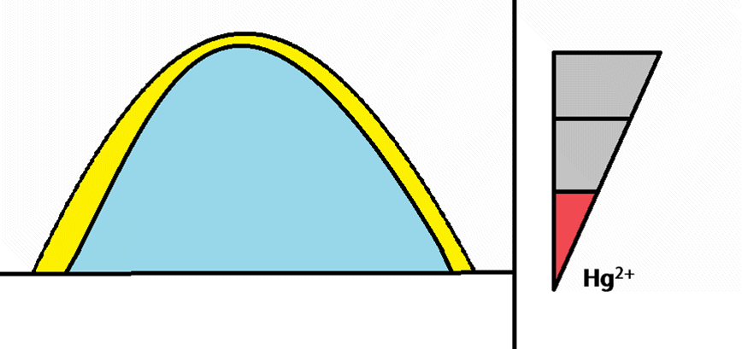
Xfilm——Sensorfilm

Slide 23
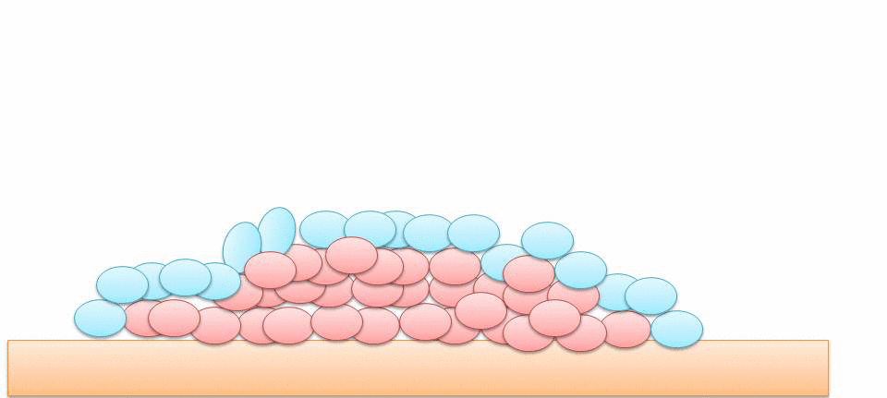
Xfilm——Gluefilm

Slide 24
ZJU-CHINA-2011

Slide 25
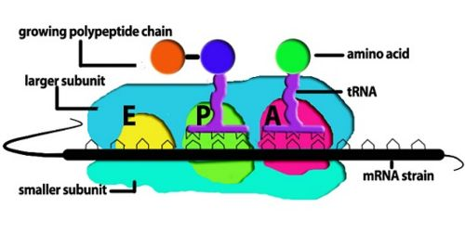
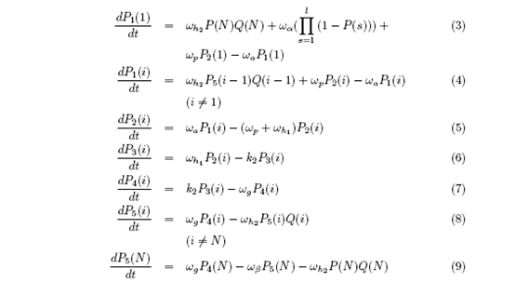
Ribosome Stages

