Slide 1
Synthetic Biology Lab Techniques

Slide 2
Outline
Motivation - To increase genetic circuit stability under mutation
Plasmids and cells (E. coli).
Restriction enzymes
PCR amplification
Electrophresis
Gibson assembly
Transformation
Selection of colonies
Colony PCR, freezer stocks
DNA sequencing
Plate reader
Flow cytometer, microscope

Slide 3
Synthetic biology projects
Noise-induced ultra-sensitivity and gradual responses
Mean and noise levels need to be controlled.
RBS library and inducible promoters
Enhancing the robustness of genetic circuits under mutations
Fitness = Growth rate
Original Gene
Circuit
Original Gene
Circuit
Single Mutation
#2
Single Mutation #1
Single Mutation
#2
Single Mutation #1

Slide 4
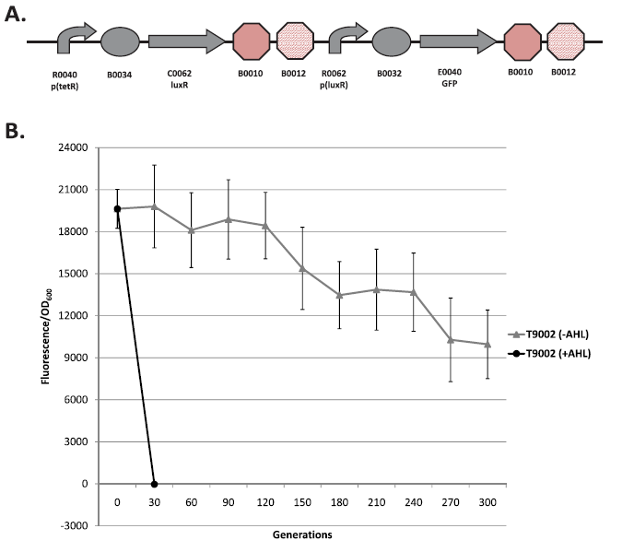
Gene circuit stability vs. gene expression levels
LuxR – from bacteria found in the ocean (vibrio fischeri).
Regulates luciferase.
TetR – Tet repressor protein that binds to tetracycline, or its homolog, ATc.
AHL

Slide 5
Gene circuit stability vs. expression level

Slide 6

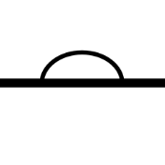
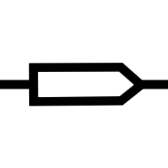
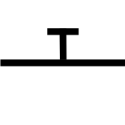
Hypothesis
Fitness is inversely related to the total gene expression levels.
Fitness landscape design can enhance gene circuit stability.
ptet RBS araC Terminator
para/lac RBS RFP Terminator
Supplementary Gene Circuit

Slide 7

Hypothesis
Fitness is inversely related to the total gene expression levels.
Fitness landscape design can enhance gene circuit stability.
ptet RBS araC Terminator
para/lac RBS cI RFP Terminator
pλ RBS lacI Terminator

Slide 8
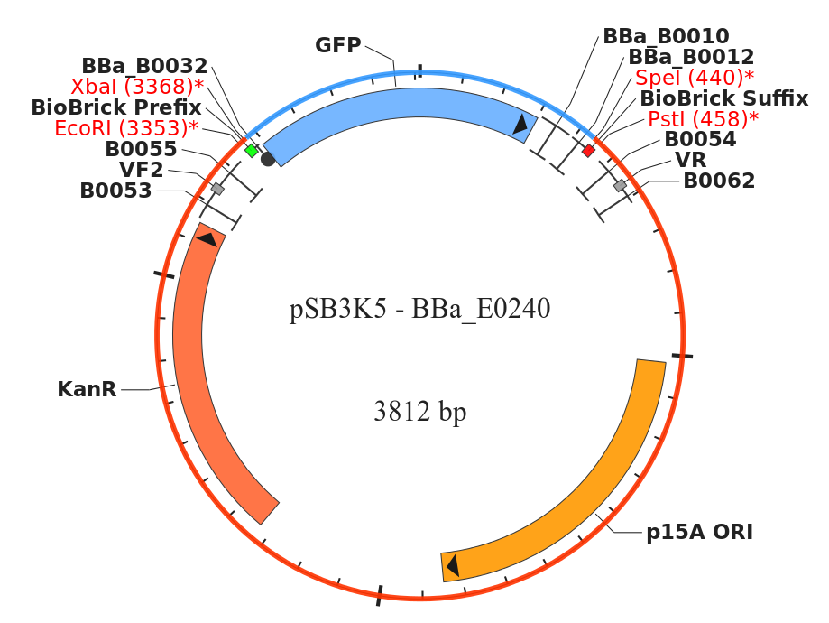
Plasmid circuit construction
What is a plasmid? Circular double stranded DNA. Vectors. Used to express particular genes. Resistant to particular antibotics. Restriction sites.
Plasmid vector
=
Circuit insert
+
Vector backbone

Slide 9
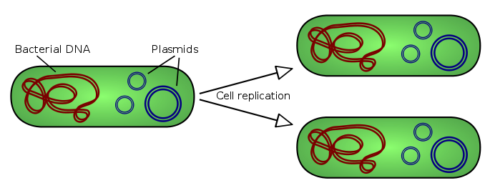
Plasmid circuit construction
Transformation
Selection by using antibiotics.

Slide 10
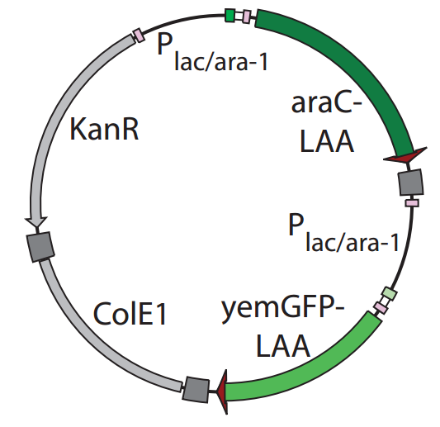
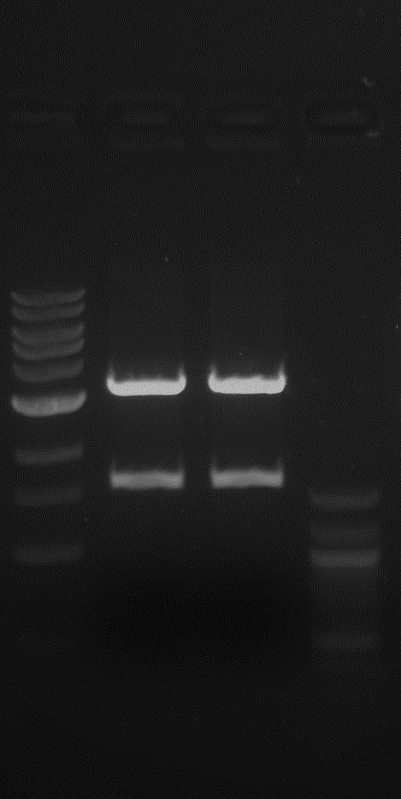
Restriction enzyme digestion
To obtain the “araC-T-para/lac” DNA fragment,
ptet RBS araC Terminator
para/lac RBS RFP Terminator
Two EcoRI restriction site
pJS167 from the Hasty’s lab

Slide 11
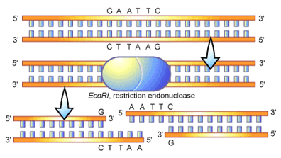
Restriction enzyme digestion
overnight incubation in the NEB1 buffer at 37°C.
Heat inactivation: 65°C for 20 min
Gel extraction protocol was performed to obtain the desired DNA fragment.

Slide 12
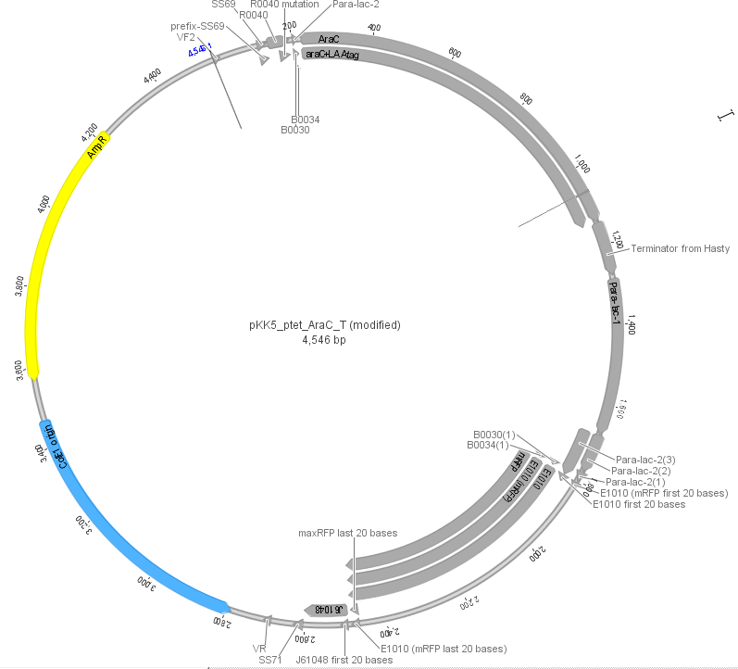
PCR amplification

Slide 13
PCR amplification
We want to construct ptet-araC-T-para/lac-RFP-T-Vector_backbone.
araC-T-para/lac = “C1”
Source template: pJS167 = Kan resistant, yemGFP expression with IPTG.
RFP-T-Vector_backbone-ptet = “C2” where the vector backbone is pSB1A2 = high copy plasmid (copy number = 100-300), amp resistant.
Source template: pJL37 = T9002-E, pSB1A2, Amp resistant, RFP expression (AHL added in the cloning strain called the NEB Turbo).
pKK5 | Template | F | R | H2O | DMSO | 2x Phusion | Temp | Size
C1 | R1 (3/22/13) | KK40 | KK22 | 10 | 0.5 | 12 | 59 | 1.6
C2 | pJL37 [red] | KK41 | KK36 | 10 | 0.5 | 12 | 59 | 3.0

Slide 14
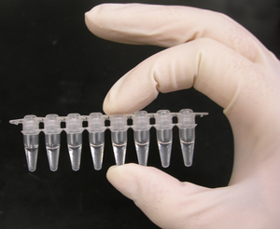
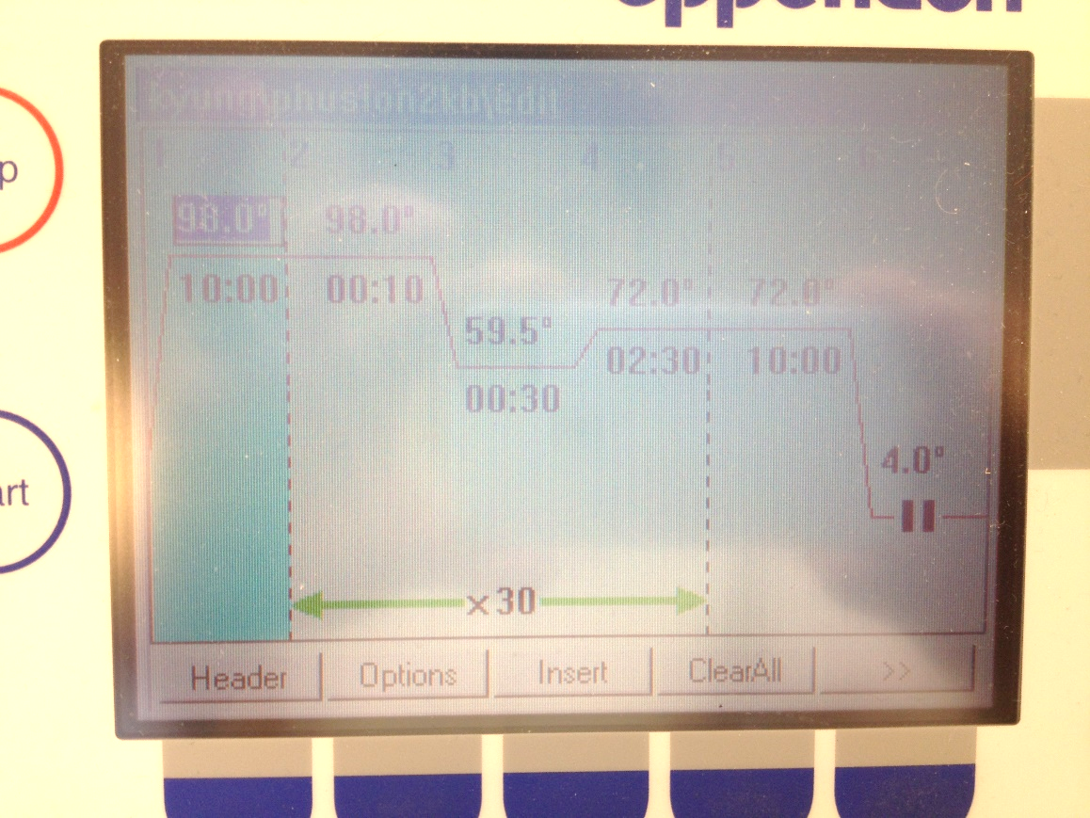
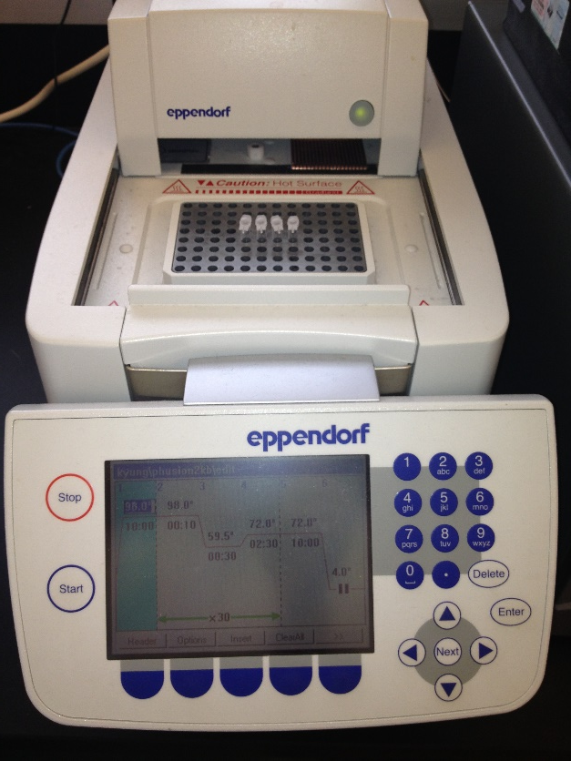
PCR (polymerase chain reaction) amplification

Slide 15
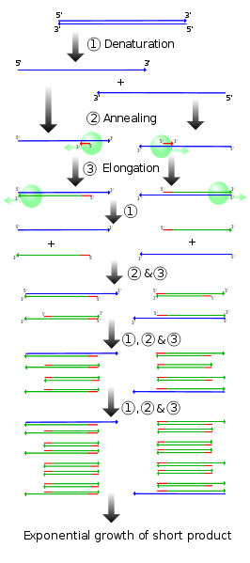

PCR amplification
1
2
3

Slide 16
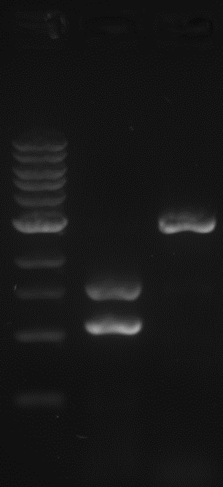
PCR amplification
2x phusion: High Fidelity DNA polymerases from New England Biolabs.
Thermostable (even stable at 98°C)
Generates blunt-ended products.
High fidelity and speed
3’-5’ exonuclease – to remove base pair mismatch.
Pyrococcus-like enzyme fused with a processivity-enhancing domain
Low error rate >50 fold lower than that of Taq DNA Polymerase 6 fold lower than that of Pyrococcus furiosus DNA Polymerase
pKK5 | Template | F | R | H2O | DMSO | 2x Phusion | Temp | Size
C1 | R1 (3/22/13) 0.5μL | KK40 0.5μL | KK22 0.5μL | 10μL | 0.5μL | 12μL | 59°C | 1.6kb
C2 | pJL37 [red] 0.5μL | KK41 0.5μL | KK36 0.5μL | 10μL | 0.5μL | 12μL | 59°C | 3.0kb

Slide 17
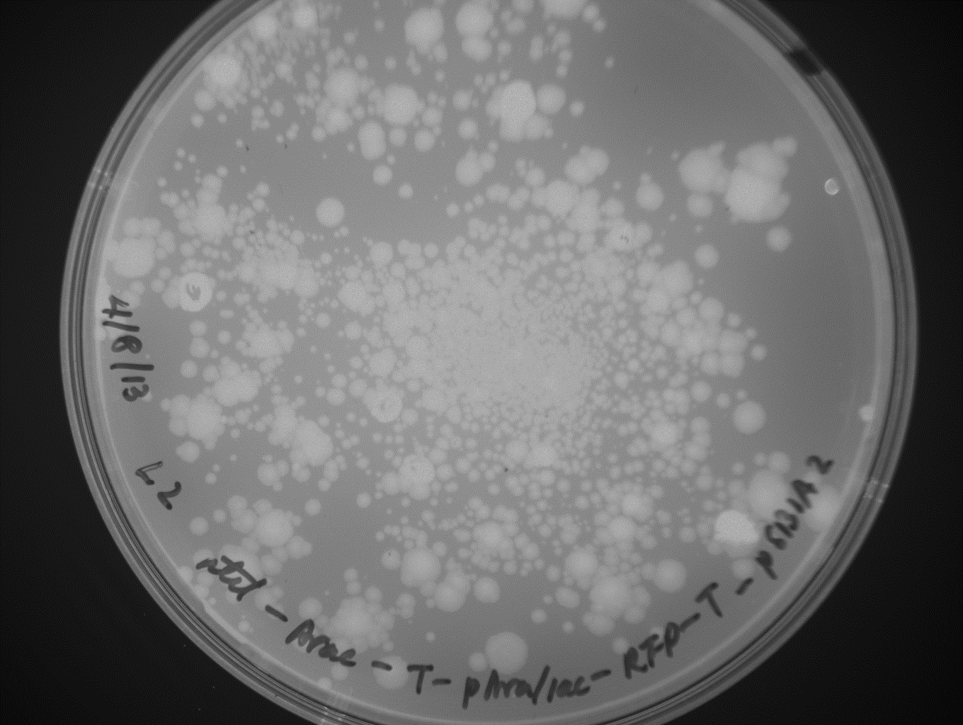
After DNA assembly,
Red colonies – mutants or background
White colonies – right ones!

Slide 18
Primer design
Tm (melting temperature) > 58ºC
The annealing region that binds to the DNA template >18bps. Optimal = 20bps.
The homologous region between the two DNA amplified fragments that will be assembled together (by the Gibson method) >15bp.
Primer length < 60bp. Otherwise, it will be expensive. $.15/bp
The length of sequence except the binding region to the DNA template < that of the binding region.
The 3' end of primer = g or c.
Any sequence repeats? To prevent mispriming and primer dimerization.

Slide 19

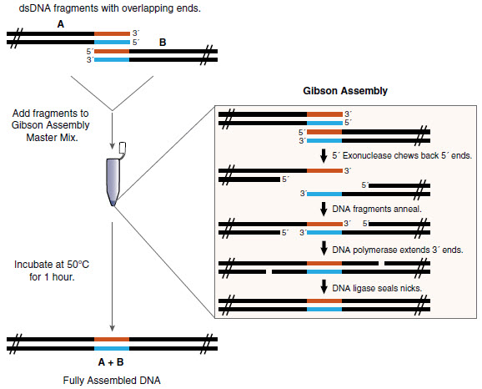

Cloning procedure
PCR amplification
Gel Electrophoresis
PCR purification
Gibson Assembly
(ligation)
Transformation of cloning strains
DNA sequencing
Transformation of expression strains
Measurement
Mini-prep
Bind-wash-elute:
Spin columns, buffers, and collection tubes or silica-membrane-based purification of PCR products >100 bp

Slide 20
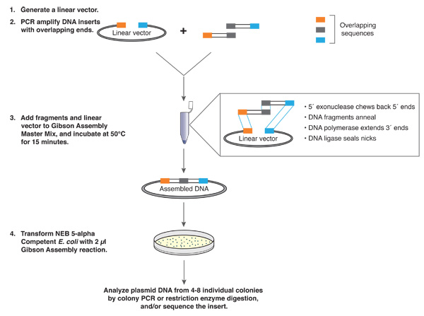
Gibson assembly

Slide 21
Cloning procedure
PCR amplification
Gel Electrophoresis
PCR purification
Gibson Assembly
(ligation)
Transformation of cloning strains
DNA sequencing
Transformation of expression strains
Measurement
Mini-prep

Slide 22
Transformation of E. coli
Cloning strains (e.g., NEB Turbo) for reliable and efficient production of plasmids
Endonuclease I, endA1, is eliminated for highest quality plasmid preparations.
Restriction enzyme EcoK is removed. EcoK cleaves -AAC(N₆)GTCG- if the second A is unmethylated.
McrBC is removed. McrBC cleaves DNA containing methylcytosine on one or both strands.
High transformation efficiency.
Tight control of expression by lacl^{q} (overproduction of LacI) allows potentially toxic genes to be cloned. -35 site in promoter upstream of lacI is mutated from GCGCAA to GTGCAA.
Highest growth rate on agar plates - visible colonies 6.5 hours after transformation.
Resistance to phage T1: The bacteriophage T1 can be transmitted by aerosolization, which makes it one of the most dangerous E.coli phages in high throughput laboratories and genomic centers.
K12 Strain.

Slide 23
Cloning procedure
PCR amplification
Gel Electrophoresis
PCR purification
Gibson Assembly
(ligation)
Transformation of cloning strains
DNA sequencing
Transformation of expression strains
Measurement
Mini-prep

Slide 24
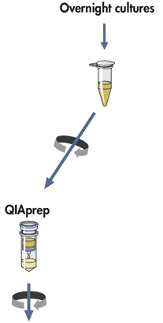

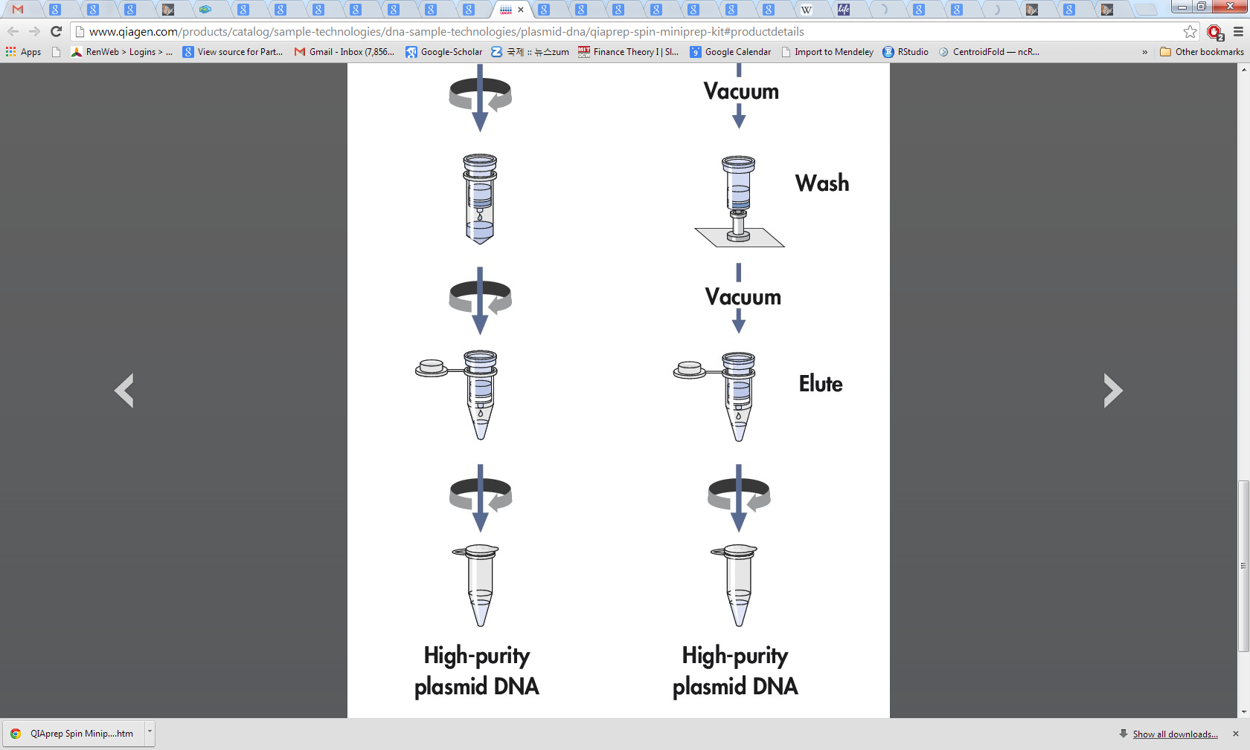
Mini-prep (QIAprep Kits)
Plasmid purification: bind-wash-elute procedure
Bacterial cultures are lysed and the lysates are cleared by centrifugation.
The cleared lysates are then applied to the QIAprep module where plasmid DNA adsorbs to the silica membrane.
Impurities are washed away.
Pure DNA is eluted in a small volume of elution buffer or water.
1
3
2
4

Slide 25
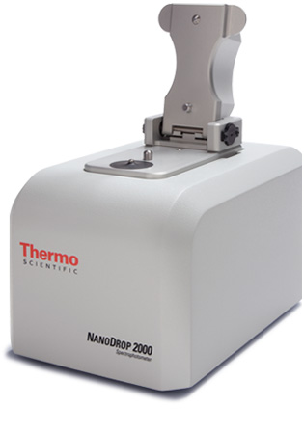
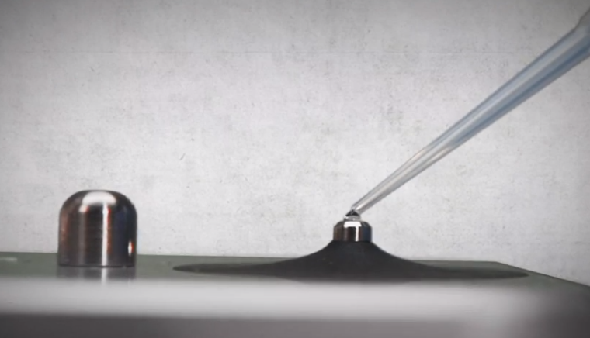
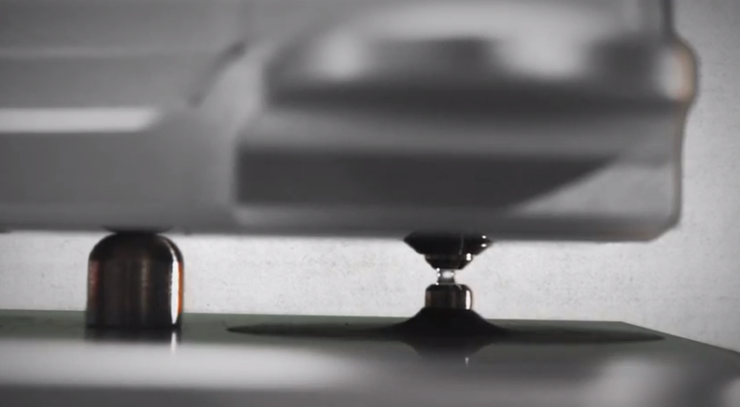
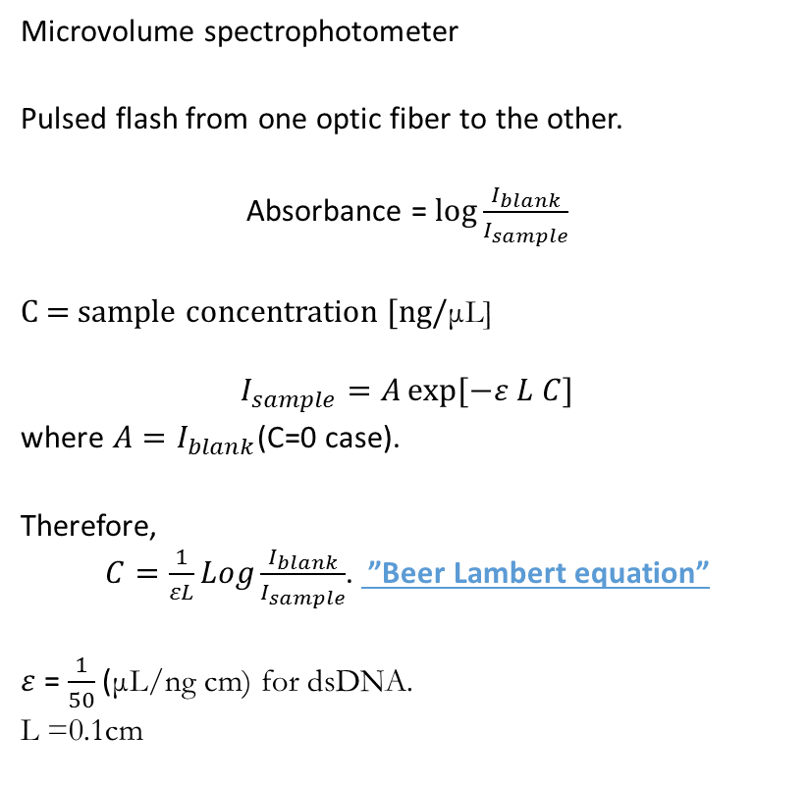
DNA concentration measurement: Nucleic acid quantification
Microvolume spectrophotometer
Pulsed flash from one optic fiber to the other.
Absorbance = $\log{\frac{I_{blank}}{I_{sample}}}$
C = sample concentration [ng/μL]
$$I_{sample}=A\exp{[−ε L C]}$$
where $A=I_{blank}$(C=0 case).
Therefore,
$C=\frac{1}{εL}Log\frac{I_{blank}}{I_{sample}}$. ”Beer Lambert equation”
$ε$ = $\frac{1}{50}$ (μL/ng cm) for dsDNA.
L =0.1cm
Optic fiber
Optic fiber

Slide 26
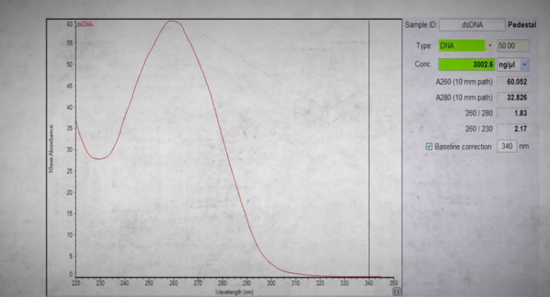

DNA concentration measurement: Nucleic acid quantification
Nucleic acids absorbs ultra-violet light ~ 260nm.
Protein absorbs light ~ 280nm.
The ratio of $\frac{A_{260}}{A_{280}}$ quantifies the purity of DNA compared to proteins.
$\frac{A_{260}}{A_{280}}≃$ 1.8 for pure DNA solution.
absorbance
wavelength

Slide 27
Cloning procedure
PCR amplification
Gel Electrophoresis
PCR purification
Gibson Assembly
(ligation)
Transformation of cloning strains
DNA sequencing
Transformation of expression strains
Measurement
Mini-prep

Slide 28
Cloning procedure
PCR amplification
Gel Electrophoresis
PCR purification
Gibson Assembly
(ligation)
Transformation of cloning strains
DNA sequencing
Transformation of expression strains
Measurement
Mini-prep

Slide 29
Cloning procedure
PCR amplification
Gel Electrophoresis
PCR purification
Gibson Assembly
(ligation)
Transformation of cloning strains
DNA sequencing
Transformation of expression strains
Characterization of engineered cells
Mini-prep

Slide 30
Gene circuit characterization
MG1655Z1:
Chromosomal expression of araC
Constitutive chromosomal expression of lacI and tetR
Fluorescence proteins
TetR
ATc
ptet RBS araC Terminator
arabinose
para/lac RBS RFP Terminator
Question: How can we make the cells red?

Slide 31
Gene circuit characterization
w/o ATc
TetR
RFP/OD (AU)
ATc
ptet RBS araC Terminator
arabinose
Jayit Biswas (BIOE undergrad)
para/lac RBS RFP Terminator
Chromosomal expression araC is strong enough to activate the para/lac hybrid promoter.

Slide 32
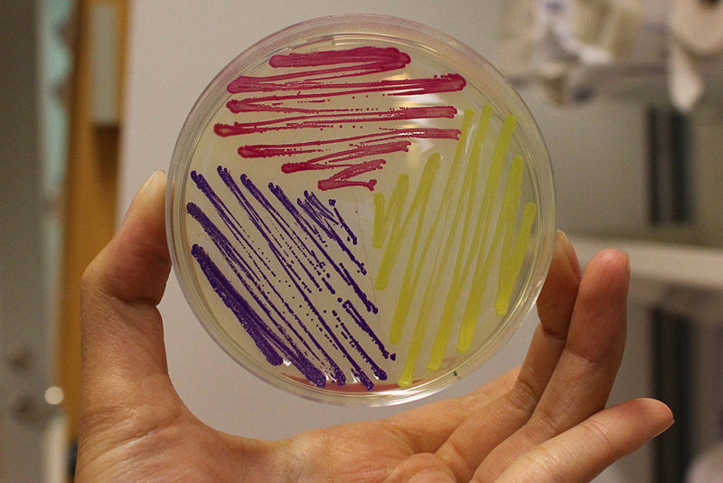
RFP
Red fluorescent protein from Discosoma striata (coral)
mCherry and most RFP’s were derived from Discosoma species.
Excitation = 584 nm
Emission = 607 nm
584, 625nm used to reduce interference.
Fast folding
Codon optimized for E. coli
http://partsregistry.org/File:AmilCP_amilGFP_RFP.jpg
amilGFP BBa_K592010 (yellow) amilCP BBa_K592009 (blue) RFP BBa_E1010 (red)

Slide 33
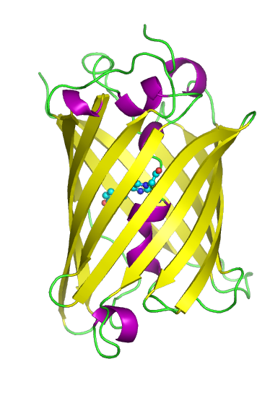
GFP
Noninvasive fluorescent marker in living cells.
green fluorescent protein from Jelly fish (Aequorea victoria)
fluorophore (Ser-Tyr-Gly), protected inside β barrel.
Mutants
EGFP, yemGFP
YFP, CFP, BFP
GFPmut3b (E0040)
excitation = 501nm
emission = 511nm
half life = 41 hrs (2008 igem KULeuven) Degradation tags (LVA) > 74min
485, 525nm used to reduce interference.

Slide 34
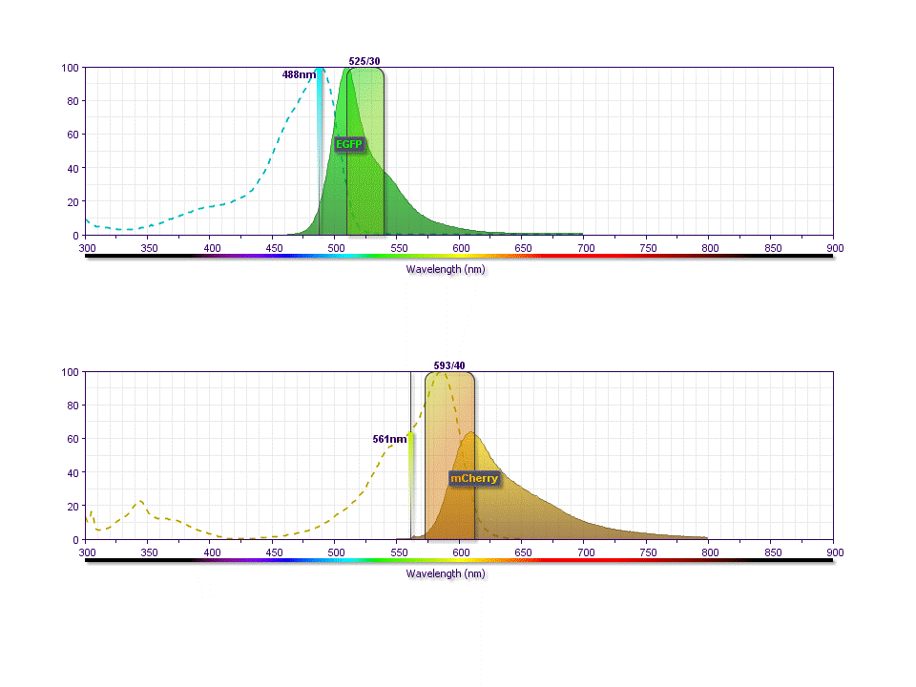
Spillover
Spill-over from GFP fluorescence to the filter 593/40

Slide 35
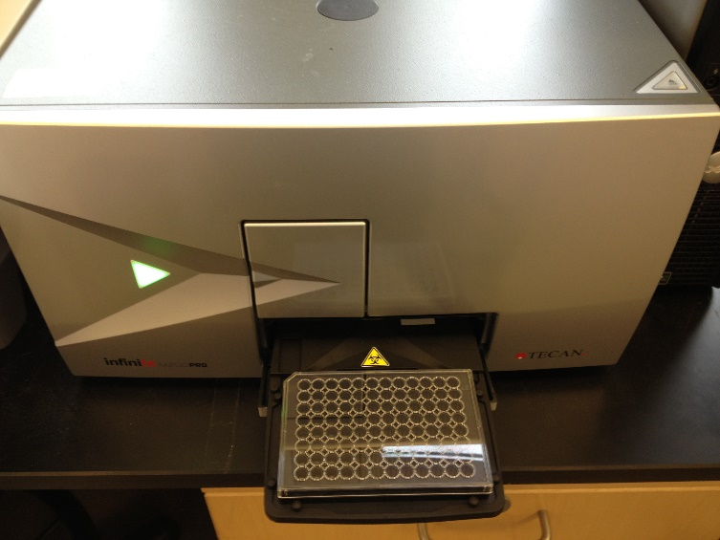
Plate reader (microplate spectrophotometer)
OD (optical density): absorbance of light at 600nm wavelength.
Fluorescence intensity for various wavelengths.
Measurement at a series of time points.
Fluorescence/OD: Autofluorescence of cells: For example, MG1655 has a strong auto-fluorescence with green light. OD of LB media is high. Linear relationship between OD and the sample concentration? Lag-log(logarithmic, exponential)-stationary phases?
Tecan

Slide 36
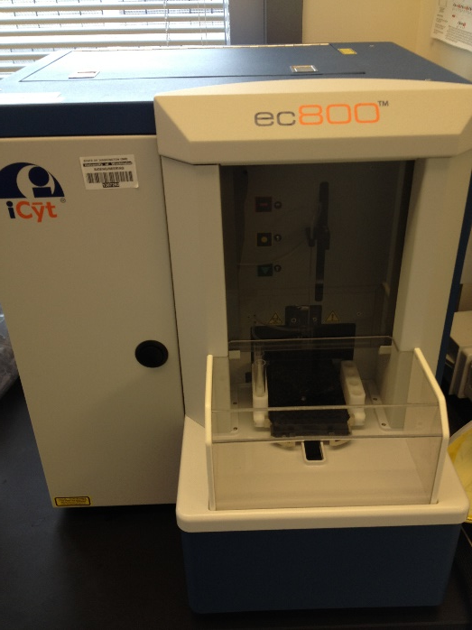
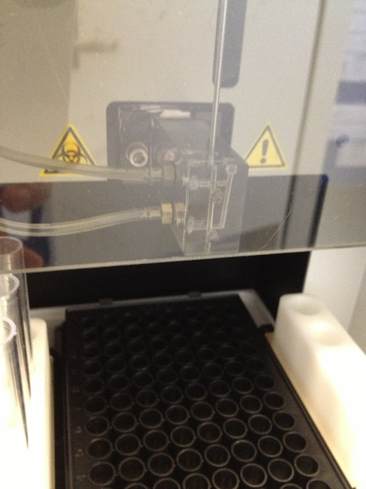
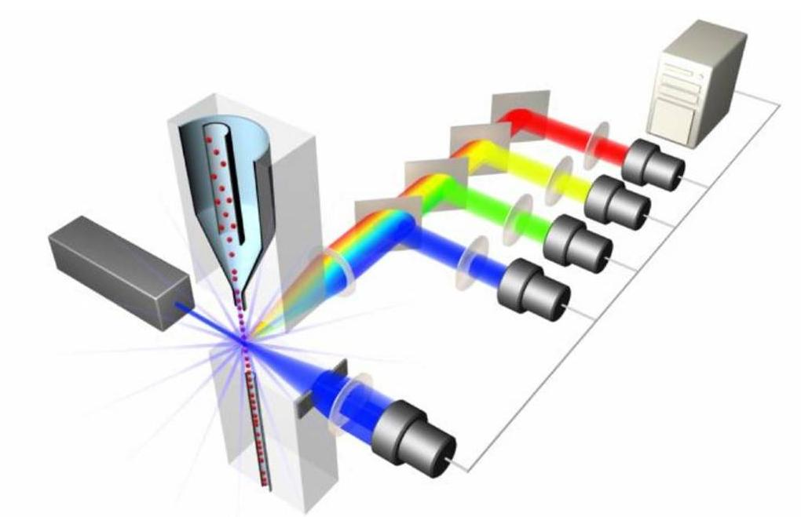
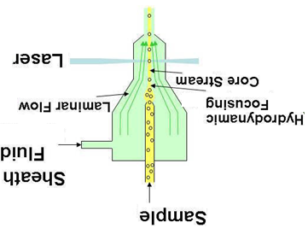
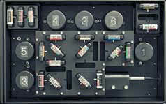
Flow Cytometry
Side Scatter
iCyt
Flow-through Chamber
Forward Scatter
Flow cell
4 lasers can be installed. (488nm, 561nm)
PMT (photo-multiplier tube).
Optic Fiber

Slide 37
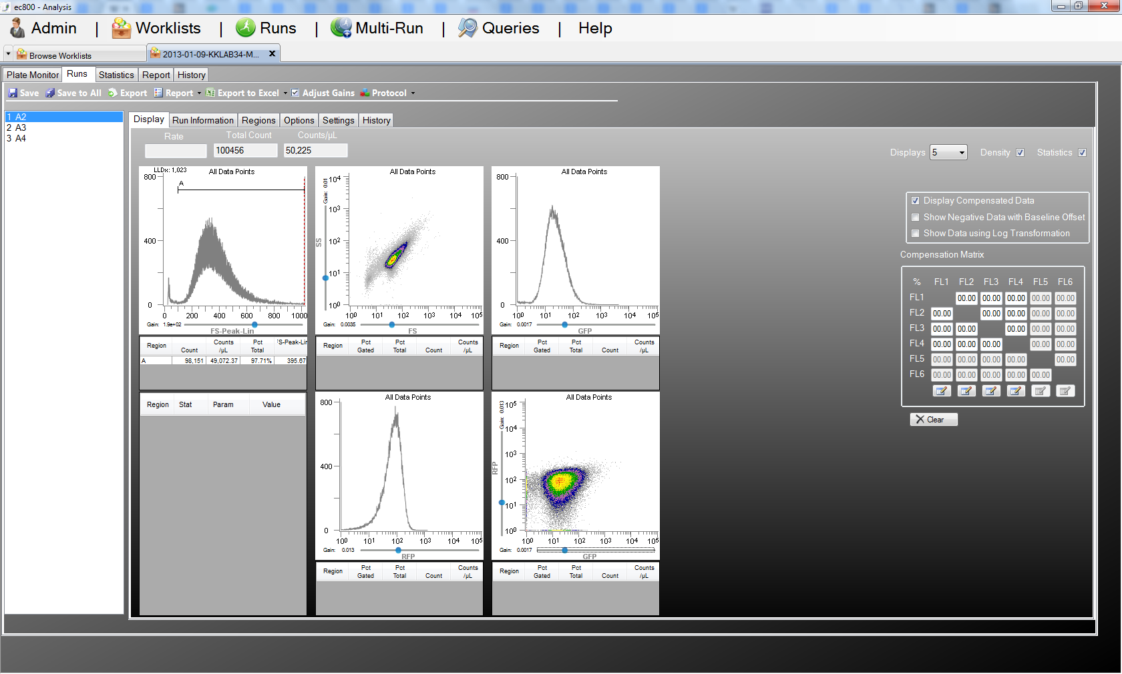
Flow cytometer
ptet RBS luxR RBS GFP Terminator
AHL
plux RBS RFP Terminator
SS
FS Peak
FS
GFP
RFP
Compensation Matrix
RFP
GFP

